Slide 1

US FDA’s Data Analysis

Slide 2
Business Understanding
U.S. Food and Drug Administration (FDA) is a federal agency responsible for safeguarding public health in the United States.
The FDA's mission is to protect and promote public health by ensuring the safety and effectiveness of a wide range of products and substances.
iVision is collaborating with FDA to perform Data analysis on FDA’s dataset

Slide 3
Data understanding
Let’s see what data do we have for Analysis.
Product Details, Approval Details, Chemical Details, Application Details etc.
Data
Format - Sql Script

Slide 4
Data preparation
How did i organize the data for modeling?
Checked Duplicate Data Entry. ( Found None )
Ignored Chemical type, doctype, appdoc type tables

Slide 5
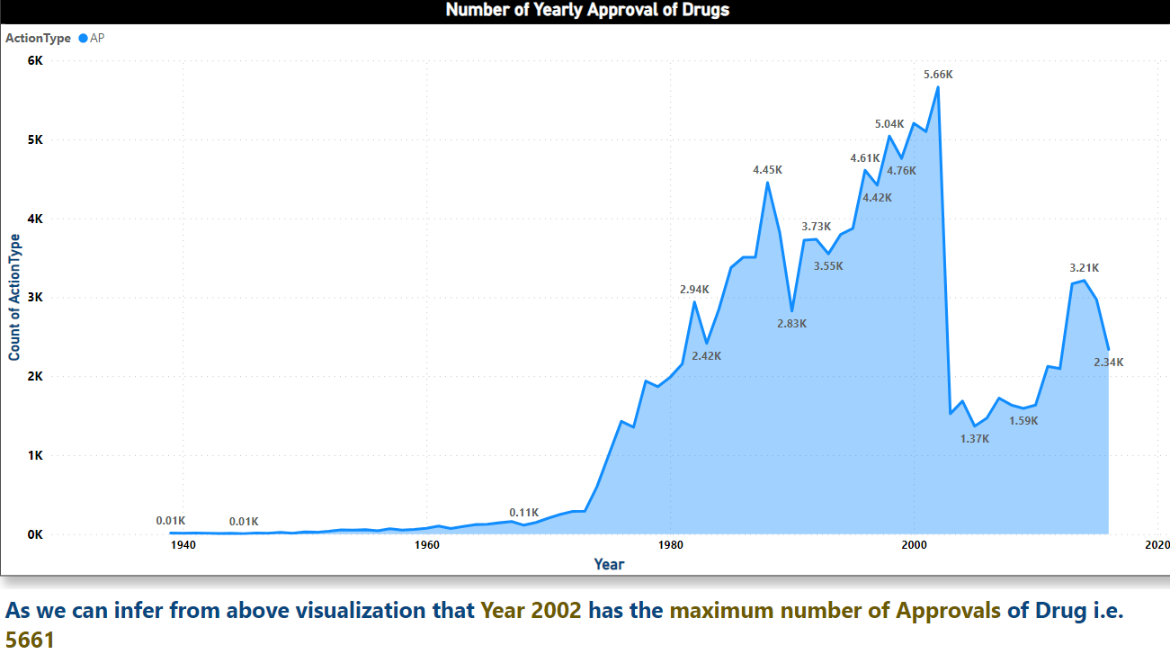
Findings / Evaluation
Yearly approval trends of drugs :-

Slide 6
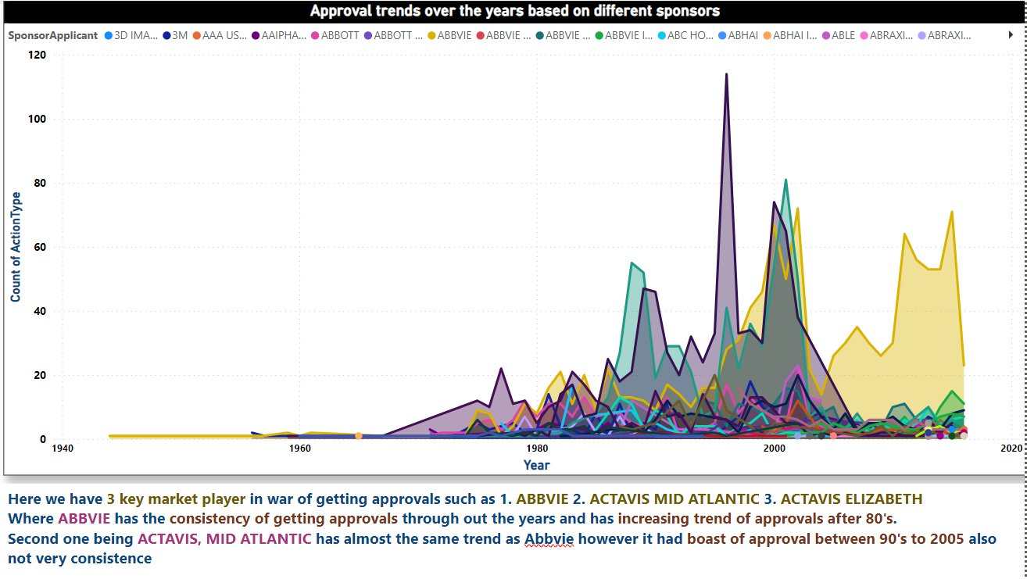
Findings / Evaluation
2. approval trends over the years based on different sponsors :-

Slide 7
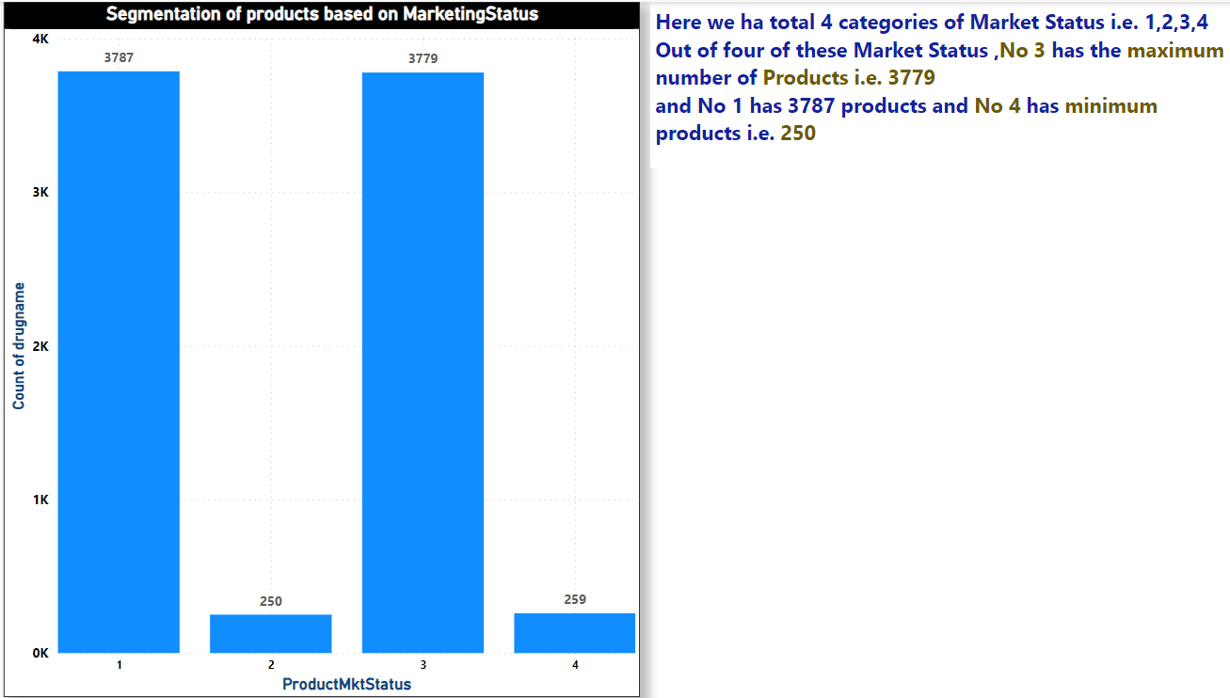
Findings / Evaluation
3 . segmentation of products based on Marketing Status

Slide 8
Findings / Evaluation
4 Show the total number of applications for each Marketing Status. Enable users to filter by years and Marketing Status
Go to Dashboard

Slide 9
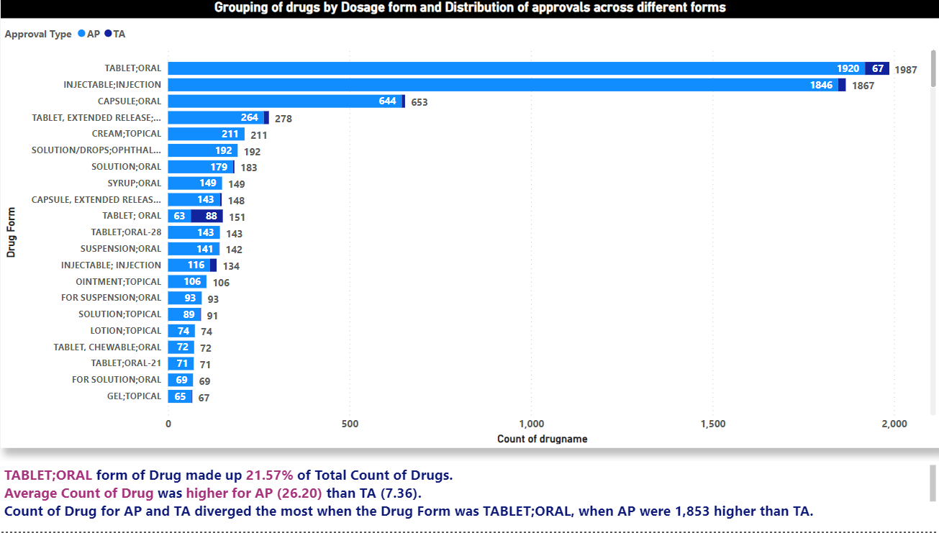
Findings / Evaluation
5 grouping of drugs by dosage form, distribution of approvals across different forms, Identify the most successful dosage form.

Slide 10
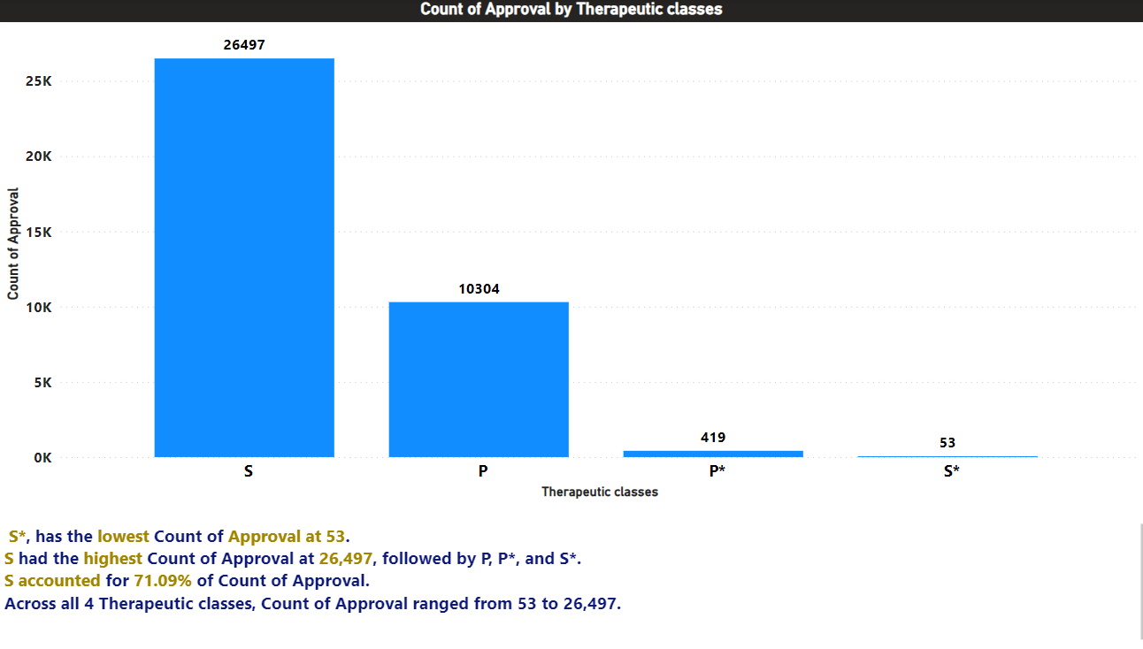
Findings / Evaluation
6 Drug approvals based on therapeutic classes, Identify classes with the highest number of approvals.

Slide 11
SQL Queries

Slide 12
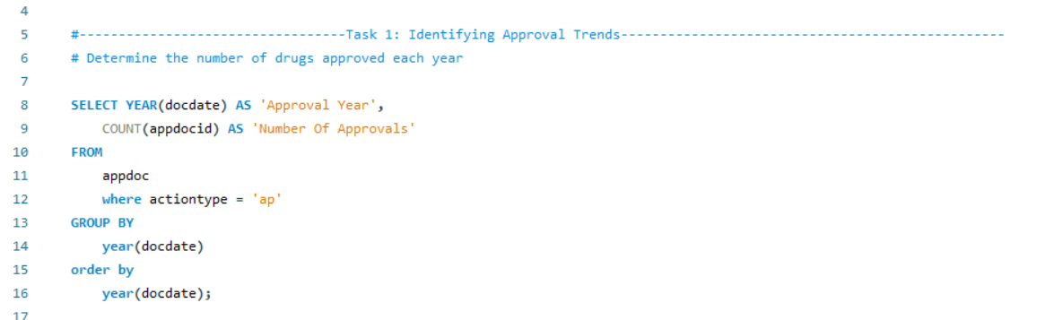

Slide 13
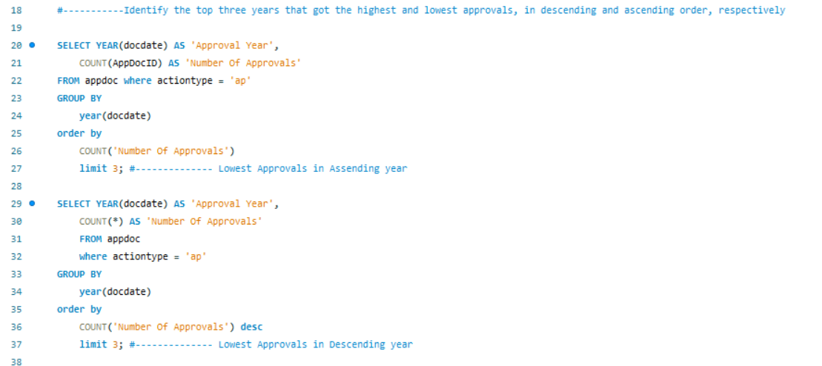

Slide 14
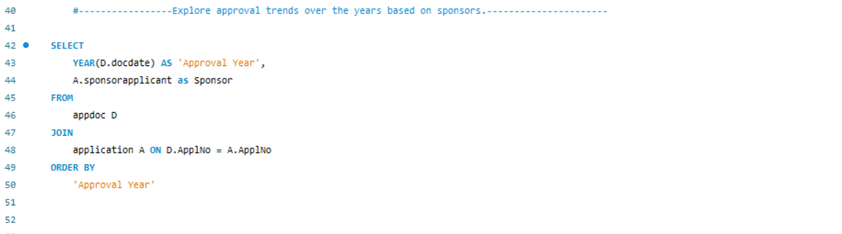

Slide 15
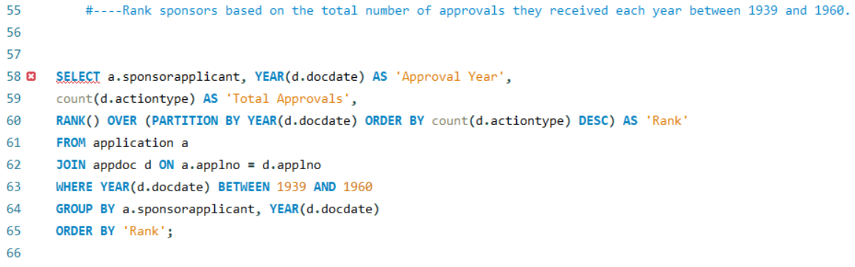

Slide 16
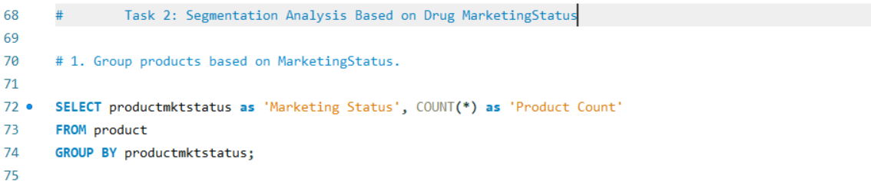

Slide 17
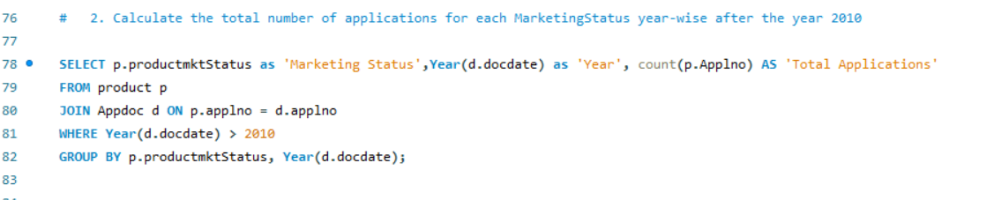

Slide 18
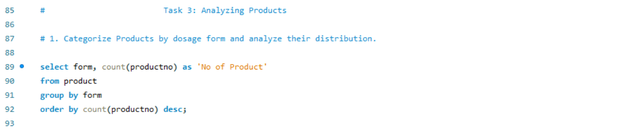

Slide 19
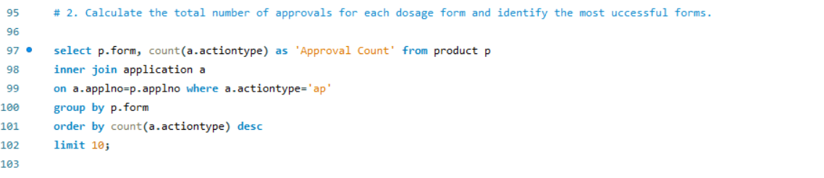

Slide 20
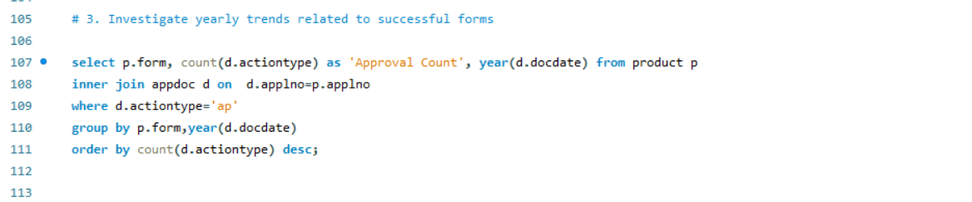

Slide 21
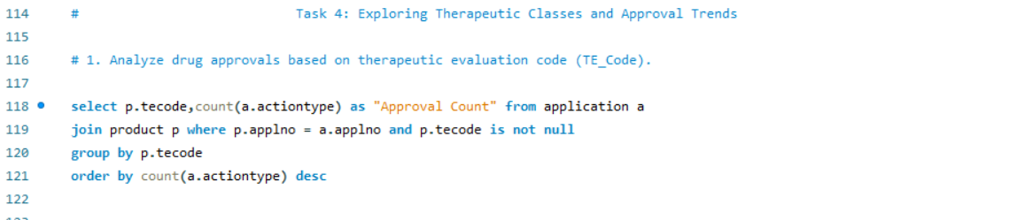

Slide 22
Thank You

